Slide 1
New

Slide 2
XXX Project
Group X
Name: xx xx xx

Slide 4
Requirement analysis for the XX project
Introduction to the XX Project Solution
Value and Benefits of XX Project
Sharing of project experience and gains

Slide 5
Requirement analysis
01
02
03
Separating Stateful and Stateless Services
Creating a Docker Container Image
Creating a Kubernetes Cluster and Deploying Container Images

Slide 6
Requirement analysis for the XX project
Introduction to the XX Project Solution
Value and Benefits of XX Project
Sharing of project experience and gains

Slide 7
Solution Introduction
Notes:
Common RPM commands:
Installing a package: rpm -ivh
Upgrading a package: rpm -Uvh
Removing a package: rpm -e
Installation options:
--force forcibly installs a package even if the package overwrites files in another package.
--nodeps forcibly installs an RPM package even if its installation depends on other packages that are not installed.
Querying whether a package is installed: rpm -q < rpm package name>
Obtaining information about an installed package: rpm -qi < rpm package name>
Listing files in a package: # rpm -ql < rpm package name>
Listing the RPM package that housing a server file: rpm -qf
Combining multiple options: rpm -qil < rpm package name>
Listing all installed RPM packages: rpm -qa
Listing files contained in an RPM package that is not installed in the system: rpm -qilp < rpm package name>

Slide 8
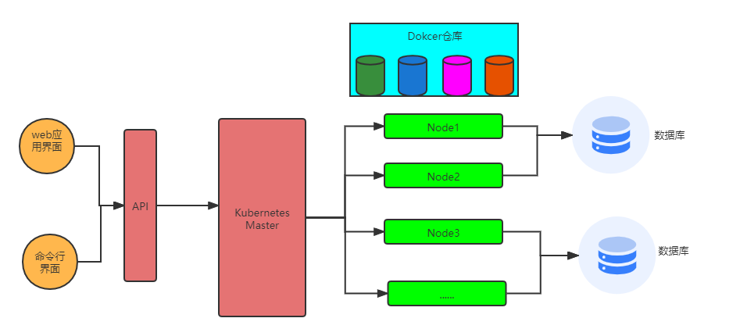
Solution Introduction
03 Kubernetes Cluster Implementation

Slide 9
Requirement analysis for the XX project
Introduction to the XX Project Solution
Value and Benefits of XX Project
Sharing of project experience and gains

Slide 10
Project Value and Benefits
01
02
03
Physical server utilization
Smooth application upgrade
Node Scalability

Slide 11
Requirement analysis for the XX project
Introduction to the XX Project Solution
Value and Benefits of XX Project
Sharing of project experience and gains

Slide 12
project experience and gains

